Slide 1
MRS GREN

Slide 2
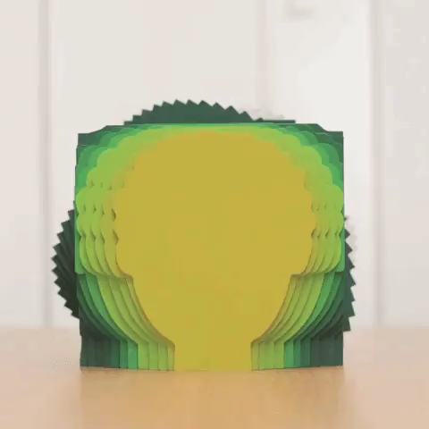
By the end of this lesson, you should be able to:
1. | Define living, non-living, alive and dead.
2. | Explain the acronym MRS GREN and each life process.

Slide 3
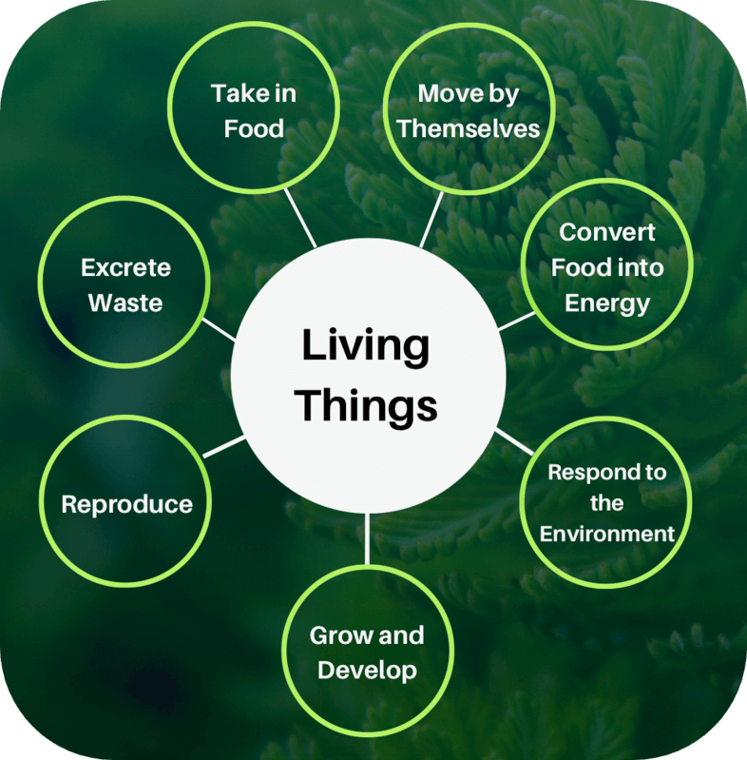
All living things carry out these seven life processes:

Slide 4
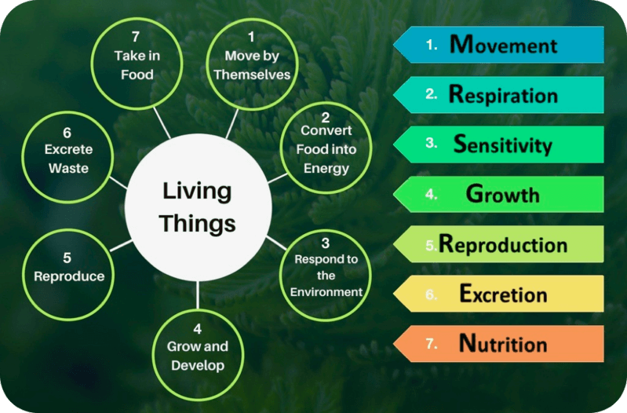
A good way to remember these seven life processes is by using the acronym MRS GREN.

Slide 5
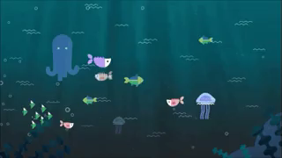
An organism must carry out all seven of these processes to be classified as alive.
If something carries out some of the processes but not all, it cannot be classified as alive. When living things die, we say they are dead or no longer living.
Non-living things are things that have never been alive. This means that fossil dinosaurs would be classified under living things, because they were once alive.

Slide 6

Here is a diagram to recap all this:

Slide 7
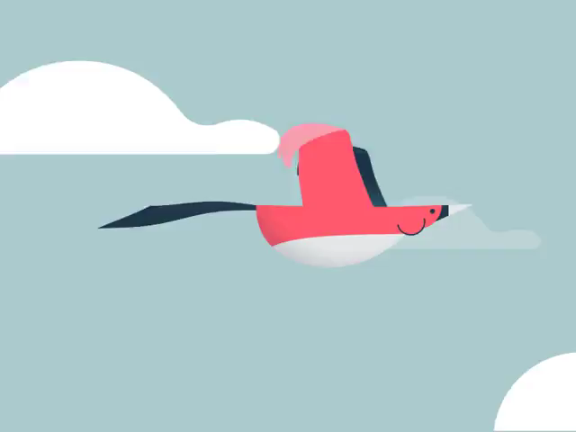
One of the first things that many living things do is move!
Animals move using specialised structures, like legs or wings to help them survive.

Slide 8
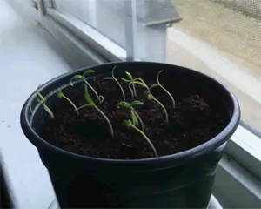
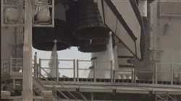
Did you know plants move too?
They don't move their whole "body" like animals do, but they can move parts of themselves (like moving their leaves toward the sun).
Non-living things, like rocket ships, can only move if they are pushed or pulled by something else.

Slide 9
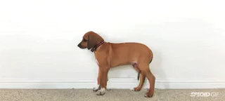
All living things grow as they get older.
Most animals grow until they reach a certain size and then stop. Most plants continue growing throughout their entire lives.

Slide 10
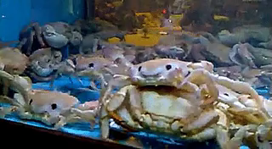
When you grow, your skin grows with you.
But some living things, including spiders, snakes, crabs, and most insects have hard exoskeleton or a skin which does not grow with them.
Snakes need to cast off their skin to grow while crabs need to get rid of their exoskeleton.

Slide 11
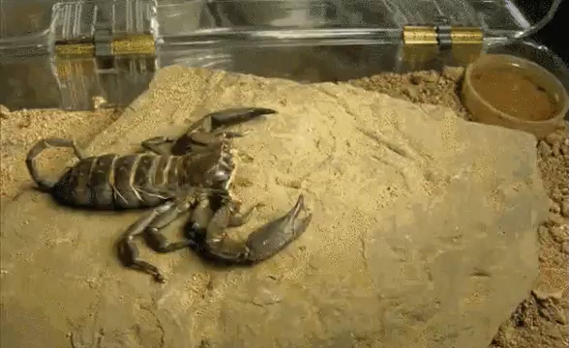
When they grow too big for their exoskeleton or their skin, those animals must shed it in a process known as moulting.
Check out the gifs below to see a cicada and a scorpion moulting (the process is actually slower)!

Slide 12
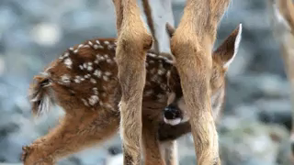
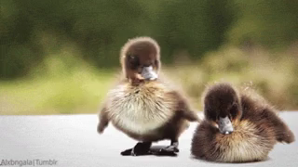
All living things are also capable of reproduction.
Reproduction means that the organism can produce offspring, or babies!

Slide 13
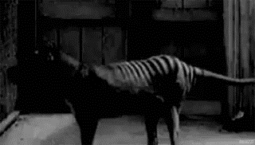
Reproduction is important to ensure that the species survives.
If organisms of a species do not successfully reproduce, the species will eventually die off and become extinct.
The Tasmanian tiger went extinct in 1936, after the last captive individual died.

Slide 14

There are two types of reproduction.
Sexual reproduction is when a cell from a female and a cell from a male combine to create a new cell. Most animals and plants reproduce in this way.
Asexual reproduction is when one cell splits into two identical cells, as you can see below. Unicellular organisms, like bacteria, reproduce in this way.

Slide 15
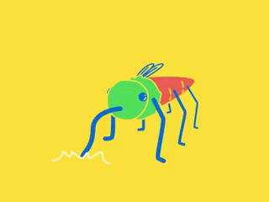
How do living things get the energy to do all of this moving, growing, and reproducing?
They get it through nutrition! Nutrition is the process by which organisms take in and use food, which is made up of nutrients.
Most plants take in nutrients from the soil through their roots. Animals must eat other organisms for nutrition.

Slide 16
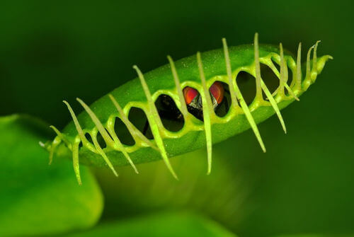
Not all plants get their nutrients by absorbing them from the soil.
Some plants are carnivorous, which means they eat insects and sometimes even small rodents!
The Venus flytrap shown below is a species of carnivorous plant that mainly eats ants, but will also eat flies, beetles and spiders!

Slide 17
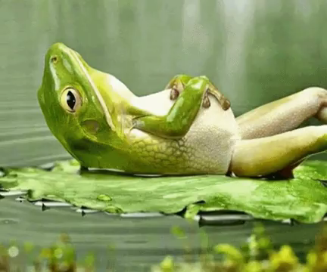
The food that organisms take in through eating or other processes needs to be broken down into a useful form.
This is why living things carry out respiration.
You might think that respiration is breathing, but it is actually a chemical process that turns oxygen and food into energy. Plants do not breathe, but they do carry out respiration!

Slide 18
Animals take in oxygen through their lungs, fish breathe with their gills, and plants use their leaves.
Check out this link for an animation of different ways of breathing!
During respiration, glucose (sugar) from food and oxygen are converted into energy which is used for all the processes that keep things alive.

Slide 19
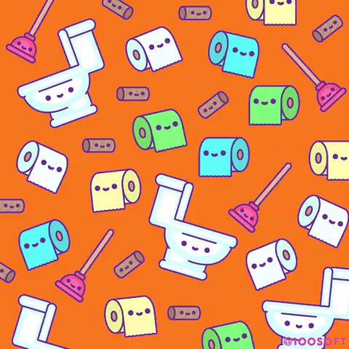
Not all of the substances that organisms take in are useful.
Respiration and photosynthesis that occur in organisms also create waste products.
All living things remove waste products through a process called excretion.

Slide 20
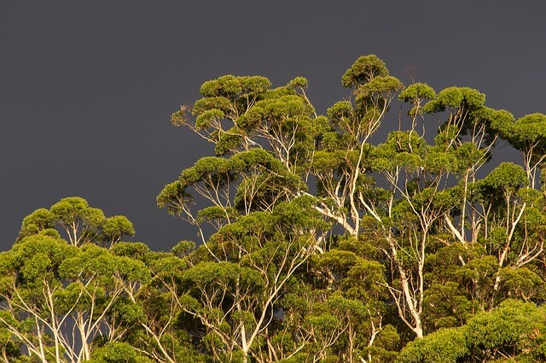
Animals breathe in oxygen and excrete carbon dioxide.
Luckily for us, plants absorb carbon dioxide and excrete oxygen! Without these plants and other species, such as algae, that can excrete oxygen we would not be able to survive.

Slide 21
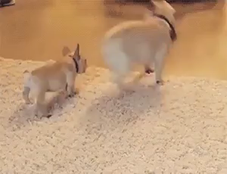
All living things are sensitive to the environment around them.
For example, you will know that if you touch something hot, it hurts and you respond by quickly moving your hand away.
Animals generally respond very quickly to changes in their environment. Plants also respond but usually much more slowly than animals.

Slide 22
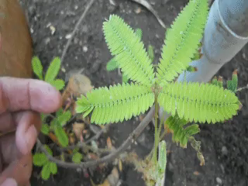
However, not all plants respond slowly.
Mimosa pudica is also known as the "sensitive plant" or the "shame plant", because when its leaves are touched or shaken, they rapidly fold inward.
You can see the Mimosa in action below!

Slide 23

A stimulus is a change in the environment that causes a response.
Senses are used to detect stimuli. Humans have many senses including the five you may know: smell, taste, sight, touch, and hearing.
We also have other senses like proprioception which means you know where parts of your body are even when your eyes are closed!

Slide 24
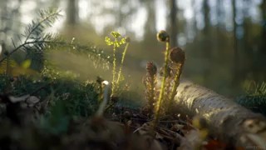
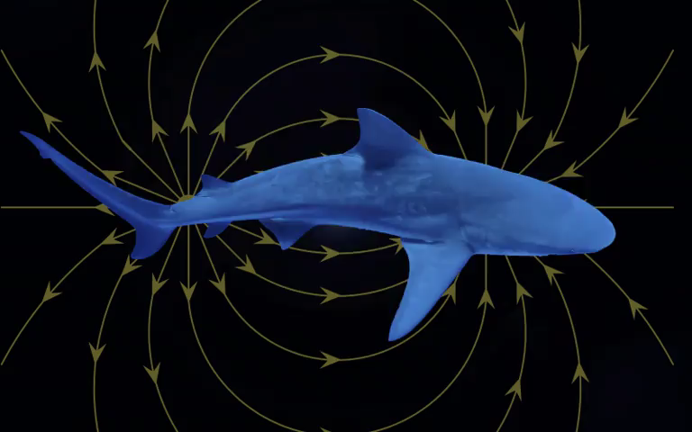
Plants can sense the light, so that they can grow towards it.
Some animals, like sharks, have electroreception, which means they can sense electrical stimuli.
Other animals, like pigeons, have magnetoreception. This means they can sense magnetic fields!

